Slide 1

PROGRAMMING METHODOLOGY (PHƯƠNG PHÁP LẬP TRÌNH)
UNIT 1: Computing Fundamentals

Slide 2
Lecturer Information
Pham Cong Thien (T. Thien / Thomas)
Senior Manager of Capgemini VN.
FX_Scale_Up (24+ Engineers) / FullStack Lead.
tg_phamcongthien@tdtu.edu.vn / congthienvn@gmail.com
0988 533 468

Slide 3
Acknowledgement
The contents of these slides have origin from School of Computing, National University of Singapore.
We greatly appreciate support from Mr. Aaron Tan Tuck Choy for kindly sharing these materials.

Slide 4
Policies for students
These contents are only used for students PERSONALLY.
Students are NOT allowed to modify or deliver these contents to anywhere or anyone for any purpose.

Slide 5
Recording of modifications
Currently, there are no modification on these contents.

Slide 6
Unit 1: Computing Fundamentals
Hardware and Software
Program Development
Programming Environment
sunfire – a UNIX machine
vim – a text editor
File transfer

Slide 7


Hardware
Monitor and speaker (output)
Houses processor, memory, buses, etc.
Software
Set of instructions to perform tasks to specifications
Programs are software
Keyboard and mouse (input)
http://www.tutorialspoint.com/computer_fundamentals/computer_quick_guide.htm

Slide 8
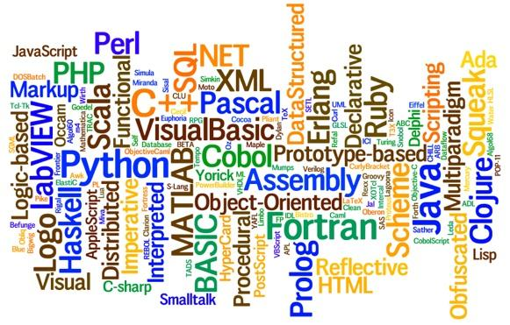
(Computer) Program
Sequence of instructions for a computer to execute
Programming languages
Languages for writing programs
Software

Slide 9
Types of Programs
Machine code
Assembly code
High-level language program
Program to which computer can respond directly. Each instruction is a binary code that corresponds to a native instruction.
Eg: 0001001101101110
Low-level language with strong (generally one-to-one) correspondence between assembly code and machine code instructions.
Eg: MIPS (add t1, t2, t3)
Requires translation
Detailed knowledge of the machine is not required. High level of abstraction. Ease of writing and understanding.
Eg: Java, C, C++, Python.

Slide 10
Translation of Programs
High-level language programs (eg: C) cannot be executed directly by the computer
Require a translation process called compilation
A special program called compiler is used
The original C program is called the source code
The compiled program is the executable code or machine code
In general, executable codes generated on a certain machine cannot be executed on another machine with a different architecture
The source code needs to be compiled on the new machine

Slide 11
The Edit, Compile and Execute Cycle
Use a compiler to translate the source code into executable
Use an editor to create/modify the source code
Edit
Compile
Execute
Execute/run the executable code
Process is iterative

Slide 12
CS1010 Programming Environment (1/2)
UNIX system – the sunfire server
Every SoC student or student taking an SoC programming module can apply for a UNIX account
To login to sunfire server, you need your SoC UNIX account user-name and password.
If you don’t have a UNIX account yet, go to this link to create one (same link if you have forgotten your UNIX password):
https://mysoc.nus.edu.sg/~newacct

Slide 13
CS1010 Programming Environment (2/2)
You can do many things with your sunfire account:
Eg: Your account comes with paper quota
see https://docs.comp.nus.edu.sg/node/1732 for your print quota allocation
Some treat their sunfire account as a backup harddisk
Refer to SoC Computing Facilities web page for more general information
https://docs.comp.nus.edu.sg/cf/

Slide 14



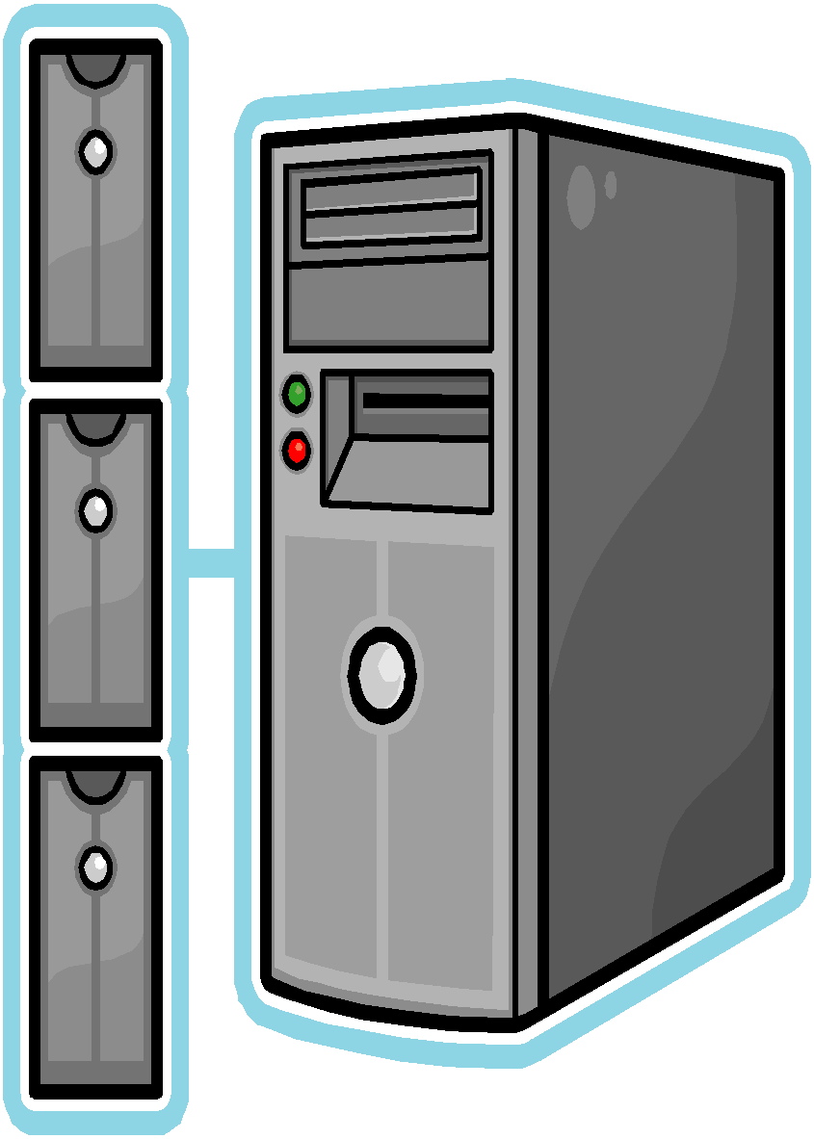

© NUS
sunfire UNIX server
or
SSH/Xshell are programs to allow users to access a remote host over a network.
To download SSH for your home use, go to http://www.comp.nus.edu.sg/~cs1010/2_resources/online.html
Intro Workshop - ‹#›

Slide 15
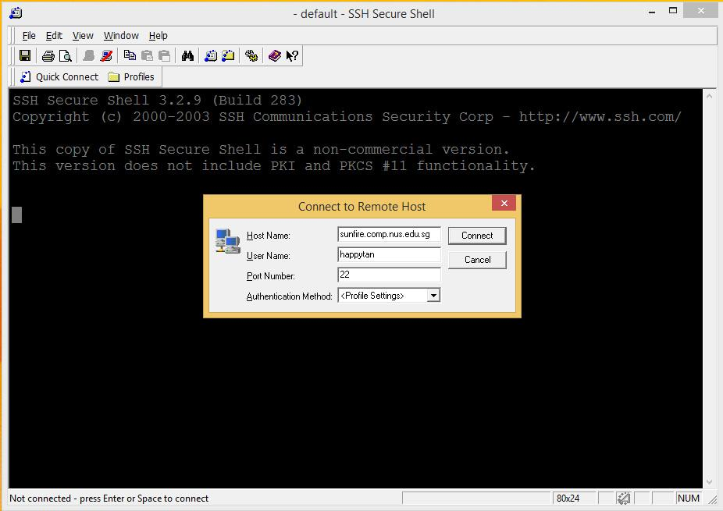
Logging into sunfire (1/2)
1. Look for the SSH Secure Shell Client icon or Xshell icon on your desktop, and double click on it. We shall assume you are using the former here.
or
Click on “Quick Connect” to get the pop-up window.
Enter “sunfire” for Host Name if connecting within campus or “sunfire.comp.nus.edu.sg” if connecting from off campus Enter your UNIX id as User Name.

Slide 16


Logging into sunfire (1/2)
1. Look for the SSH Secure Shell Client icon or Xshell icon on your desktop, and double click on it. We shall assume you are using the former here.
or
Click on “Quick Connect” to get the pop-up window.
Enter “sunfire” for Host Name if connecting within campus or “sunfire.comp.nus.edu.sg” if connecting from off campus Enter your UNIX id as User Name.

Slide 17

Logging into sunfire (1/2)
1. Look for the SSH Secure Shell Client icon or Xshell icon on your desktop, and double click on it. We shall assume you are using the former here.
or
Click on “Quick Connect” to get the pop-up window.
Enter “sunfire” for Host Name if connecting within campus or “sunfire.comp.nus.edu.sg” if connecting from off campus Enter your UNIX id as User Name.

Slide 18
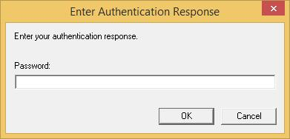
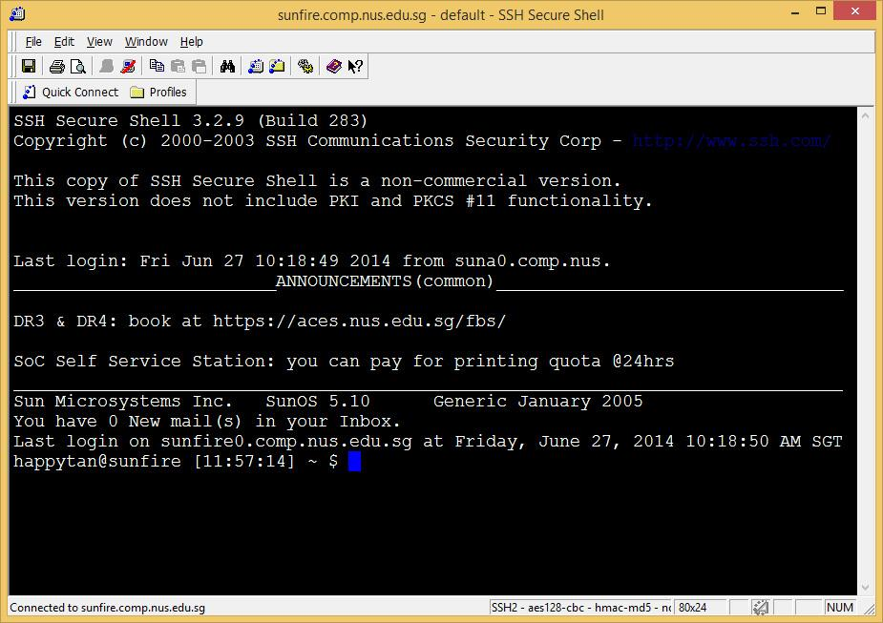
Logging into sunfire (2/2)
3. Enter your UNIX password.
4. Once you log in successfully, you will see this screen (actual display may vary).
5. To log out from your UNIX account, type “exit” or “logout”.

Slide 19
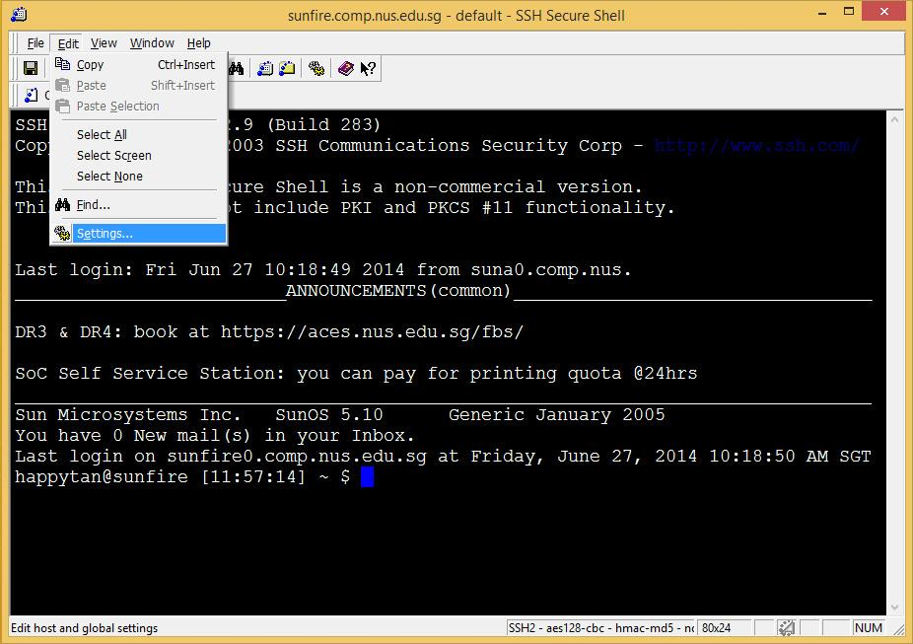
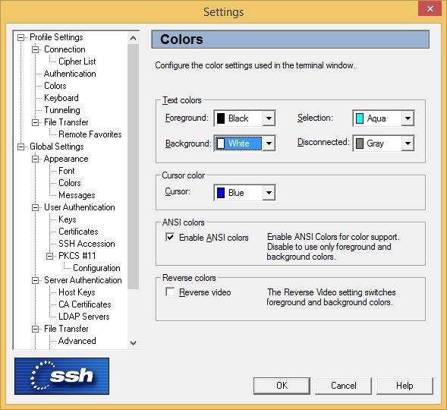
Change settings in SSH
You may change the settings in SSH (eg: font size, background colour, text colour, etc.)
For example, to change background and text colours, click on “Edit” 🡪 “Settings” and change the desired settings accordingly.

Slide 20
Trying out some UNIX commands
Type ‘ls’ (list) to list out the files in your directory
You see no list because your account is brand new. There are no files in there.
Type ‘pwd’ (print working directory) to show the pathname of your current directory
An example output: /root/home/h/happytan
ls and pwd are just two UNIX commands.
UNIX commands are case-sensitive.

Slide 21
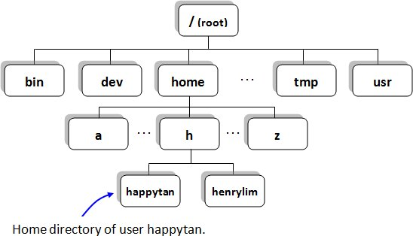
File Directories in sunfire (1/2)
Check out the pathname of your own home directory by typing ‘pwd’
/home/h/happytan

Slide 22
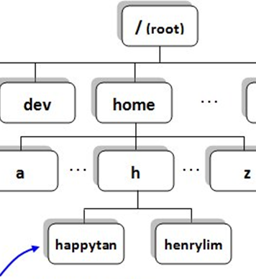
File Directories in sunfire (2/2)
When you log in, you are automatically placed in your home directory.
You are allowed to create/modify/remove files or subdirectories only under your home directory.
/home/h/happytan

Slide 23

Setting up your UNIX account
As your new account is currently bare, run the following set-up to configure your account:
~cs1010/workshop/setup
(enter y when prompted)
source .bashrc
(no response from the system is good news!)
(1) does the following in your home directory
Creates a ‘c’ subdirectory and puts a few C programs into the ‘c’ subdirectory
Copies a number of system files into the home directory, including .vimrc (vim configuration file)
You need to do this only ONCE.

Slide 24
Basic UNIX Commands (1/4)
In UNIX, typically you do a lot of typing but much less mouse clicking, compared with other operating systems like Windows
UNIX commands are case sensitive
Practice is the best way to recognize UNIX commands. Gradually you will be more and more familiar with UNIX commands – so don’t worry too much at the beginning
In sunfire, you can use the up ↑ and down ↓ arrows to select (and optionally modify) a previous command in the command log

Slide 25
Basic UNIX Commands (2/4)
Following the “Getting Started with UNIX and CodeCrunch” document (http://www.comp.nus.edu.sg/~cs1010/labs/2014/intro_lab/gettingStarted.html), your lecturer will go through these basic UNIX commands with you in class. (We will introduce CodeCrunch in the next lesson.)
Directory command | Description
pwd | Print Working Directory
ls | LiSt files in current directory
cd | Change Directory
mkdir | MaKe a subDIRectory
rmdir | ReMove an empty subDIRectory
File command | Description
cp | CoPy file
mv | MoVe file, also to rename file
rm | ReMove file
cat | CATenate file (to view a file)

Slide 26
Basic UNIX Commands (3/4)
Command options
Many UNIX commands come with options, preceded by ‘-’
happytan@sunfire [] ~ $ ls
c
The plain ls command
-F prefixes directory name with /
happytan@sunfire [] ~ $ ls -F
/c
-l displays info in long format
happytan@sunfire [] ~ $ ls -l
drwx------ 2 happytan soc06 4096 Jun 27 12:58 c
happytan@sunfire [] ~ $ ls -a
. .. .bashrc .vimrc c
-a displays hidden files (files beginning with ‘.’ in their names)
Options may be combined:
ls –al or ls –a –l
happytan@sunfire [] ~ $ ls –al
drwx------ 3 happytan soc06 4096 Jun 30 08:45 .
drwxr-xr-x 215 happytan root 8192 Jun 13 12:58 ..
-rwx------ 1 happytan soc06 434 Jun 27 12:45 .bashrc
-rwx------ 1 happytan soc06 237 Jun 27 12:45 .vimrc
drwx------ 2 happytan soc06 4096 Jun 27 12:58 c

Slide 27
Basic UNIX Commands (4/4)
Help using man command (‘man’ stands for ‘manual’)
Type man command to find out more about a certain command
Eg: man ls
Press <spacebar> to read next screen, or enter ‘q’ to quit.
Filename auto-filling
Provides auto-filling of filenames, handy for very long filenames
Press <tab> for system to fill out the rest of the filename (as much as it can)
happytan@sunfire [] ~ $ cd c
happytan@sunfire [] ~/c $ ls
example1.c example2.c example3.c
happytan@sunfire [] ~/c $ cat e 🡨 press <spacebar> after typing ‘e’ and observe
System managed to fill filename up to ‘example’ and stopped, because there are 3 filenames that begin with ‘example’. Type ‘1’, ‘2’, or ‘3’ and press <tab> for system to fill the whole filename, then press <enter>.

Slide 28
Editing C source codes (1/2)
Edit
Compile
We use a text editor to create/modify C programs (source codes)
We will use the vim editor
Execute
Source code
Editor
produces
eg: vim first.c
first.c
vim is a powerful text editor. It has 2 modes
Command mode: for issuing vim commands
Insert mode: for typing in text
To switch between command mode and insert mode
Type i in command mode to get into insert mode
Press <esc> key in insert mode to get into command mode

Slide 29
Editing C source codes (2/2)
Edit
Compile
Use vim to create this C program first.c
Execute
#include <stdio.h>
int main(void) {
int a=27, b=6, c;
c = a%b;
printf("The value of c is %d.\n", c);
return 0;
}

Slide 30
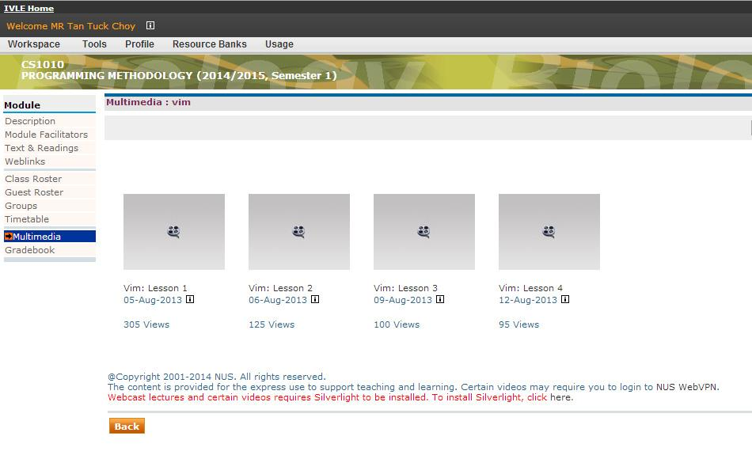
Editing C source codes (3/3)
Edit
Compile
4 videos on vim are available on IVLE
IVLE 🡪 CS1010 🡪 Multimedia 🡪 vim
Execute
CS1010 “Online” page: http://www.comp.nus.edu.sg/~cs1010/2_resources/online.html
Search the Internet

Slide 31
Compiling C programs (1/3)
Edit
Compile
We use the C compiler gcc in sunfire
Execute
Executable code
Compiler
produces
eg: gcc first.c
a.out
Advisable to add the option –Wall (warnings all) for beginners:
gcc –Wall first.c
If there are compilation errors/warnings, you need to edit the source code first.c again (vim first.c), and re-compile (gcc –Wall first.c), until your code is clear of compilation errors/warnings.
Remember to add option ‘-lm’ if your C program uses math functions
Example: gcc –Wall –lm example1.c
Type ‘ls’ to check that you have the executable code a.out

Slide 32
Compiling C programs (2/3)
Edit
Compile
The executable file has the default name a.out. However, all filenames in a directory must be unique, hence there can only be one a.out in a directory.
Execute
Since you have many C source codes in a directory (eg: example1.c, example2.c, example3.c), you might want to have their corresponding executable files all in the same directory, appropriately named.
Two approaches:
Rename a.out after compilation
Indicate the desired name of the executable file during compilation

Slide 33


Compiling C programs (3/3)
Edit
Compile
Rename a.out after compilation
Execute
happytan@sunfire [] ~/c $ gcc –Wall -lm example1.c
happytan@sunfire [] ~/c $ mv a.out example1
happytan@sunfire [] ~/c $ gcc –Wall example2.c
happytan@sunfire [] ~/c $ mv a.out example2
happytan@sunfire [] ~/c $ gcc –Wall example3.c
happytan@sunfire [] ~/c $ mv a.out example3
Executable files are named example1, example2, example3.
Indicate the desired name of the executable file during compilation using the ‘-o’ option
happytan@sunfire [] ~/c $ gcc –Wall –lm example1.c –o example1
happytan@sunfire [] ~/c $ gcc –Wall example2.c –o example2
happytan@sunfire [] ~/c $ gcc –Wall example3.c –o example3
Be careful not to overwrite the source code accidentally!
The following will replace the source code with the executable file, which is called example1.c now! The source code cannot be recovered!
happytan@sunfire [] ~/c $ gcc –Wall –lm example1.c –o example1.c

Slide 34
Executing C programs
Edit
Compile
Executing a C program is simple – just type the name of the executable file
Execute
To run the executable file example1:
happytan@sunfire [] ~/c $ example1
The distance between the 2 points is 3.61
We have gone through the Edit – Compile – Execute process
Source code
Edit
produces
first.c
eg: vim first.c
Executable code
Compile
produces
a.out
eg: gcc first.c
Program output
Execute
produces
eg: a.out
The value of c is 3.

Slide 35
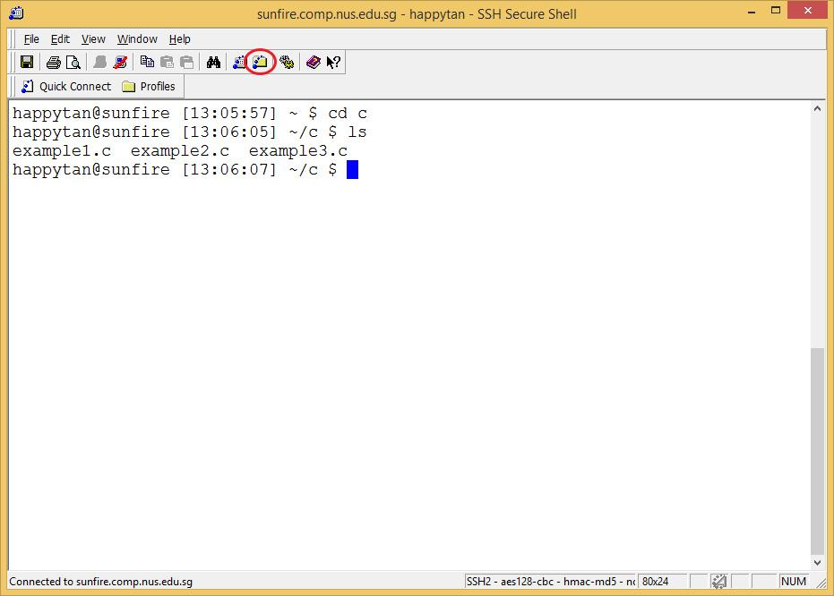
File Transfer (1/2)
To transfer files between your sunfire account and your local computer, click on the SSH Secure File Transfer icon

Slide 36

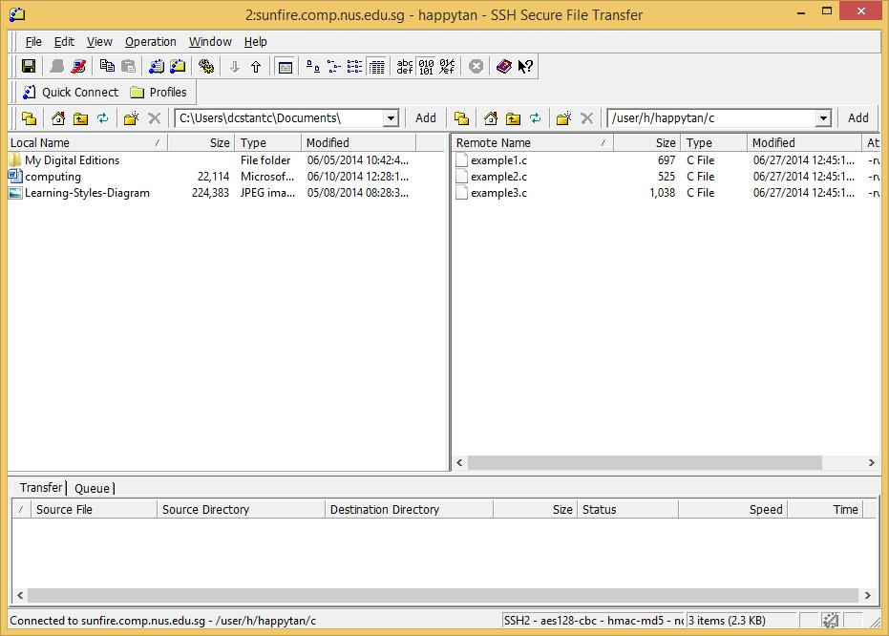
File Transfer (2/2)
Left: your local machine; right: sunfire
Choose the format: ASCII, Binary or Auto
Click on file(s) to transfer, and drag to the destination

Slide 37
Introductory Workshop
After today’s sectional class, please go through the document (http://www.comp.nus.edu.sg/~cs1010/labs/2014/intro_lab/gettingStarted.html) again and try out the commands yourself.
If you think you still need guidance, please attend the Introductory Workshop. Details on registration will be posted on the IVLE forum.
Objective:
To ensure that ALL students are ready to use the sunfire system, know basic UNIX commands, and able to edit, compile and execute C programs by next sectional class.

Slide 38
Summary
In this unit, you have
Familiarised yourself with the programming environment
Accessed the sunfire system and learned some basic UNIX commands
Used the editor vim to create/modify your C programs
Used the compiler gcc to compile your C programs
Familiarised yourself with the edit – compile – execute process

Slide 39
End of File

Slide 40
